Slide 1

Seizure Prediction: Model Generalisation
Impact of Preprocessing, Complexity, and Regularisation on Seizure Prediction Generalisation
Tahir Azam • Department of Data Science

Slide 2

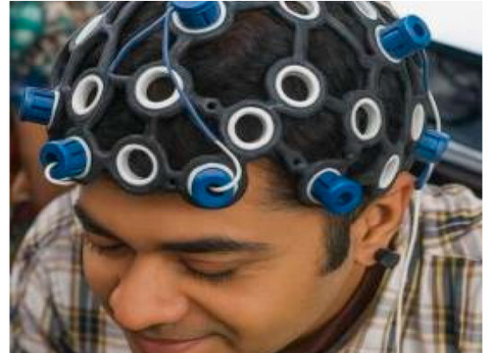
THE CLINICAL BURDEN OF EPILEPSY
Predictive Importance
Epileptic seizure prediction is critical for improving patient safety and quality of life. However, EEG data poses unique challenges:
High Noise and Non-stationarity
High Dimensionality
Extreme Class Imbalance
Models must balance accuracy with medically relevant metrics like F1-score and PR-AUC.

Slide 3
Problem Statement
Seizure events are rare (minority class), making traditional accuracy misleading. We investigate how preprocessing and regularisation stabilize these models.

Slide 4





KEY EEG DATA CHALLENGES
Noise Sensitivity
Class Imbalance
Non-Stationarity
EEG is susceptible to muscle activity, eye movements, and environmental artifacts.
Normal activity dominates recording time, often outnumbering seizures 500:1.
Patterns vary significantly between subjects and even within the same patient over time.

Slide 5
CORE RESEARCH OBJECTIVES
Preprocessing Impact: Evaluate how normalization and feature selection order affects results.
Regularisation Study: Compare L1, L2, and Elastic Net for model sparsity and generalisation.
Imbalance Strategies: Investigate SMOTE-style oversampling effects on minority class learning.
Baseline Comparison: Establish performance using Logistic Regression as a controlled classifier.

Slide 6
Methodological Foundation
Using Logistic Regression to isolate the effects of data preparation from model architecture complexity.

Slide 7


THE FOUNDATION MODEL
Logistic Regression
Evaluation Metrics
Deliberately chosen as a simple baseline. This ensures that performance variations are linked to data handling rather than model "black-box" complexity.
Standard accuracy fails in imbalanced EEG. We focus on:
•
F1-Score: Harmonic mean of precision and recall.
•
PR-AUC: Area under the Precision-Recall curve.
•
Sparsity: Number of zeroed-out coefficients.

Slide 8

REGULARISED OBJECTIVE
The penalty term adjusts based on the regularisation type (L1, L2, or Elastic Net) to control model complexity and feature importance.

Slide 9



COMPARING PENALTY TYPES
L1 (Lasso)
L2 (Ridge)
Elastic Net
Absolute value penalty. Promotes sparsity by forcing irrelevant coefficients to zero. Best for noise reduction.
Squared magnitude penalty. Keeps all features active but shrinks their influence. Best for handling multicollinearity.
A hybrid approach combining L1 and L2 penalties. Balances feature selection with stable coefficient estimation.

Slide 10
Preprocessing Pipelines
Comparing two strategic approaches to handle raw EEG signals and structured feature sets.

Slide 11
PIPELINE A: INTERPRETABILITY
Noise Removal
Logistic Reg.
Isolation Forest or filtering outliers.
Final classification on selected features.
Normalization
Feature Selection
Standardizing scales across channels.
Variance thresholding on original features.
"Maintains the physical meaning of EEG channels while reducing noise."

Slide 12
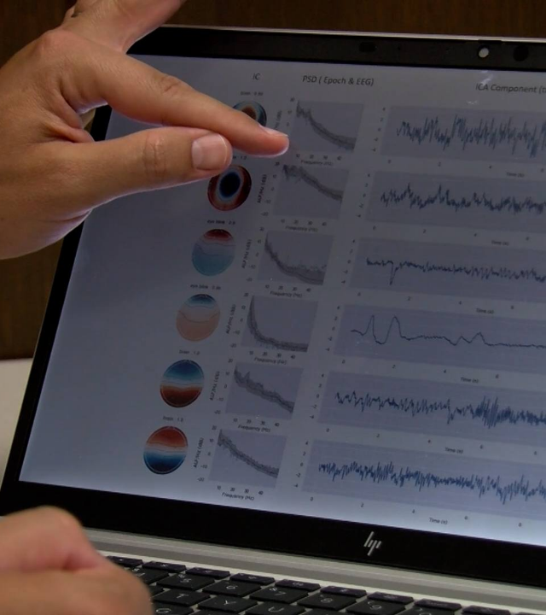
PIPELINE B: DIMENSIONALITY
Compression Strategy
Aims to compress feature space and reduce redundancy using PCA.
Feature Extraction
Scaling
PCA Transformation
Model Training
Note: PCA may lose class-discriminative info while preserving total variance.

Slide 13


PIPELINE SELECTION TRADE-OFFS
Pipeline A (Selection)
Pipeline B (PCA)
Best for structured feature sets like BEED. Directly removes noisy dimensions while keeping interpretable markers.
Best for raw continuous data like CHB-MIT. Helps convert unengineered time-series into compact representations.

Slide 14
EEG Dataset Profiles
Studying three distinct datasets representing raw recordings, structured features, and time-series segments.

Slide 15


CHB-MIT SCALP EEG DATASET
Raw Continuous EEG
Recordings from pediatric patients. Large-scale and highly realistic.
•
Size: 42.62 GB (686 EDF files)
•
Imbalance: ~20.5% seizure files
•
Challenges: Extreme noise, patient variability, and recording artifacts.

Slide 16


BEED: BANGALORE EEG
Structured Tabular Features
Cleaned and feature-engineered dataset from 80 subjects.
•
Instances: 8,000 tabular rows
•
Channels: 16 EEG features (X1-X16)
•
Ratio: 3:1 Initial imbalance
Used to test if preprocessing order matters even on clean, structured data.

Slide 17

RECOGNITION DATASET
Flattened Time-Series
11,500 segments representing 1-second EEG bursts. 178 features per sample.
Class conversion: Binary (Seizure vs All others)
Imbalance: 4:1 ratio
Use Case: Studying PCA behavior in high-dimensional feature spaces.

Slide 18
DATASET COLLECTION SUMMARY
Dataset | Data Type | Dimensions | Justification
CHB-MIT | Raw Scalp EEG | Continuous | Real-world noise; severe imbalance
BEED | Structured Features | 16 Channels | Low-dimensional clean baseline
Seizure Rec. | Flattened Segments | 178 Features | High-dimensional structured study

Slide 19
Experimental Findings
Analyzing baseline results, bias-variance trade-offs, and the specific impact of regularisation methods.

Slide 20


BIAS-VARIANCE DEMONSTRATIONS
Underfitting (Bias)
Overfitting (Variance)
Cause: Strong regularisation (low C) or limited features (top 2).
Cause: No regularisation and large feature space.
Result: Training score significantly higher than validation. Model fits noise.
Result: Poor training and validation scores. Model fails to learn patterns.

Slide 21

LEARNING CURVE ANALYSIS
Key Observations
•
High bias curves converge early at low performance levels.
•
High variance curves show a widening gap between train and test performance.
•
Optimal regularisation (L1) reduces this gap while maintaining high F1-scores.

Slide 22
PIPELINE BASELINE RESULTS
Dataset | Best Pipeline | Best F1-Score | PR-AUC
CHB-MIT | Pipeline B | 0.4771 | 0.4915
BEED | Pipeline A | 0.7094 | 0.5807
Seizure Rec. | Pipeline A | 0.5321 | 0.6616
Insight: PCA (Pipeline B) reduced BEED F1-score from 0.71 to 0.59 despite preserving variance.

Slide 23
Regularisation In-Depth
Evaluating the performance and sparsity characteristics of L1, L2, and Elastic Net across datasets.

Slide 24
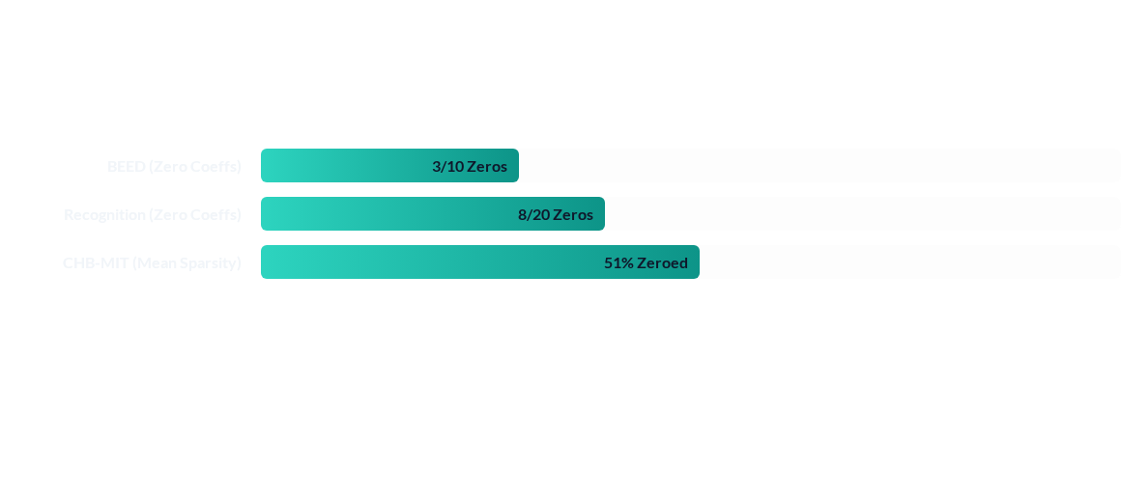
L1 SPARSITY PERFORMANCE
L1 regularisation successfully filters noisy features in higher-dimensional EEG data, reaching over 50% sparsity in raw recordings.

Slide 25
Handling Class Imbalance
Investigating how synthetic oversampling techniques like SMOTE interact with model regularisation.

Slide 26






BALANCING TECHNIQUES USED
Borderline-SMOTE
Oversampling
Post-SMOTE Regularisation
Generates samples near the decision boundary. Targeted minority-class learning.
Simple balancing of seizure vs non-seizure samples. Improves recall sensitivity.
L1 filters synthetic noise introduced by oversampling, stabilizing the boundary.

Slide 27
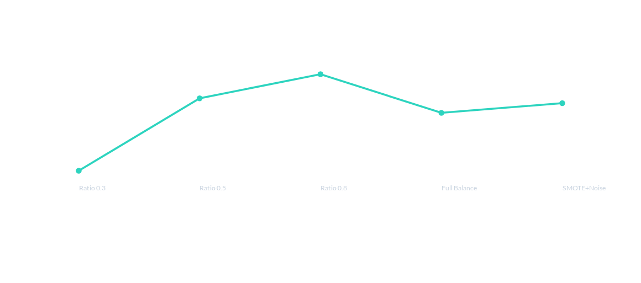
INTERACTION: SPARSITY VS SAMPLING
Interpretation: As balance increases, sparsity initially drops as the model uses more features. However, excessive SMOTE introduces noise, triggering L1 to remove redundant synthetic patterns again.

Slide 28
KEY RESEARCH CONCLUSIONS
L1 Regularisation generalised best overall, providing noise filtering and improved F1-scores.
Preprocessing Order is vital: Selection-first pipelines outperform PCA in structured EEG data.
PCA Dilution: PCA can preserve 98% variance while losing class-discriminative information.
SMOTE Interaction: Oversampling requires strong regularisation to handle synthetic noise.

Slide 29
Questions?
Investigating Preprocessing, Model Complexity, and Regularisation in Seizure Prediction
Thank you for your attention.
Contact: tahirazam539@gmail.com

Slide 30






IMAGE SOURCES
https://www.mdpi.com/brainsci/brainsci-16-00411/article_deploy/html/images/brainsci-16-00411-g002-550.jpg
Source: www.mdpi.com
https://newsnetwork.mayoclinic.org/n7-mcnn/7bcc9724adf7b803/uploads/2024/07/Dr.-David-T.-Jones-Showing-Computer-Scans-16x9-1.jpg
Source: newsnetwork.mayoclinic.org
https://media.istockphoto.com/id/1202312636/vector/pediatrics-medical-care-for-children-set-of-linear-icons-in-the-form-of-a-circle.jpg?s=612x612&w=0&k=20&c=5FQy__sUVeD2viH3KwltvsJqqSnMaKogZak6ewV2XZo=
Source: www.istockphoto.com
https://www.frontiersin.org/files/Articles/1530256/xml-images/fpubh-13-1530256-g0001.webp
Source: www.frontiersin.org
https://www.bitbrain.com/_next/image?url=https%3A%2F%2Fcms.bitbrain.com%2Fassets%2F92406523-d49c-43f8-8c5a-a6556c00f1fb&w=1920&q=85
Source: www.bitbrain.com
https://png.pngtree.com/thumb_back/fh260/background/20260505/pngtree-business-data-analysis-graphs-and-charts-image_21776993.webp
Source: pngtree.com

Slide 31

IMAGE SOURCES
https://static.vecteezy.com/system/resources/previews/042/393/007/non_2x/dark-blue-green-gradient-flowing-dot-waving-particle-geometric-technology-abstract-banner-background-digital-futuristic-navy-blue-dotted-wave-concept-for-science-music-cover-website-header-vector.jpg
Source: www.vecteezy.com

